Slide 1

MoBot
THE
DONE BY : | AISHIK KUMAR SARKAR
 | ISAAC GOH JIA RONG
 | JACK TAN XIN JIE
 | GOH XIN YANG

Slide 2
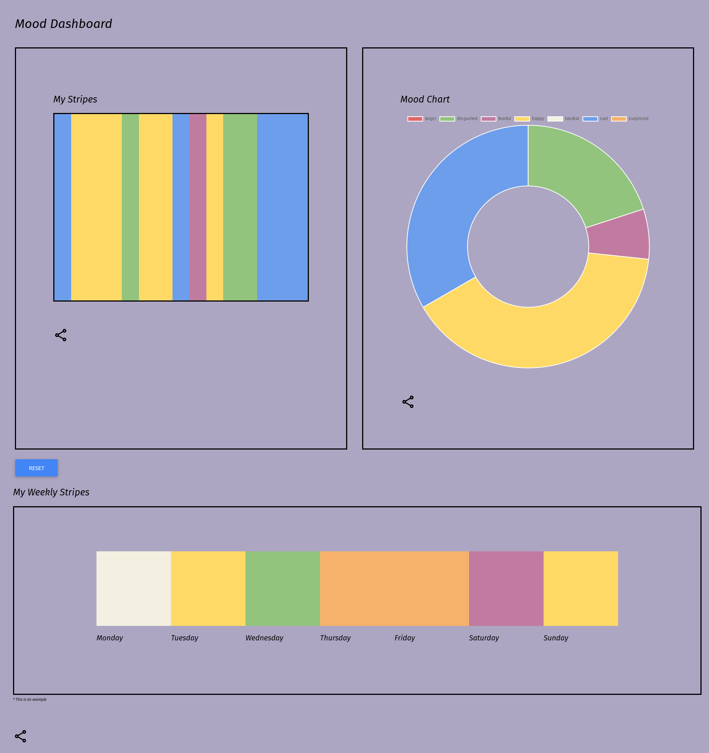


Design Concept
Camera used to detect mood
WEBSITE DASHBOARD ( SHOWING STRIPES )
AI EMOTION DETECTOR
( 7 EMOTIONS )
STRIPES GENERATOR
( A WHOLE STRIPES GENERATED FROM A DAY’S MOOD )
MOBOT
( REACTS WITH THE MOOD )

Slide 3
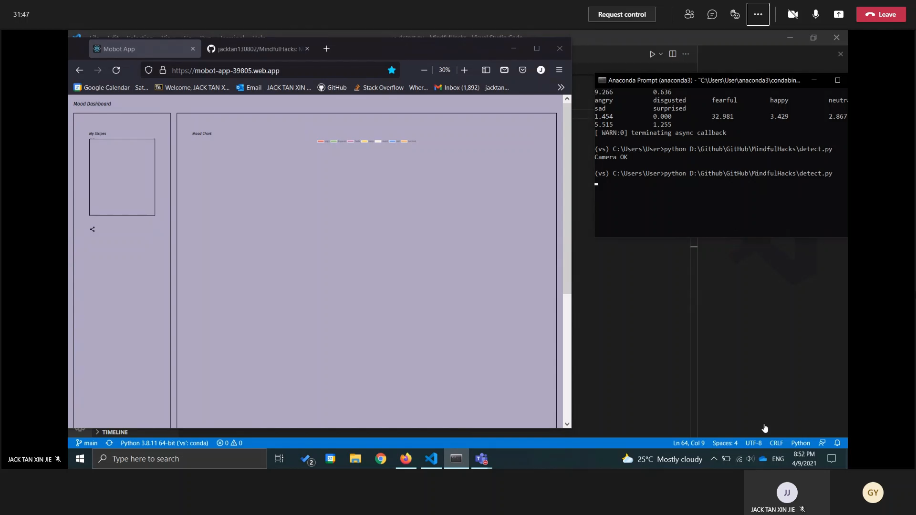
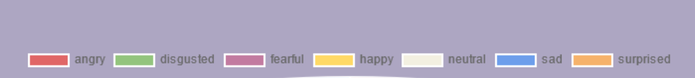
Demonstration OF AI MODEL
Notes:
Thank you aishik, I will now proceed on with the demo. After running the detect.py file which can be found in the github, the camera will start scanning for the mood of the user. As seen from the video, the gui is able to detect various feelings and is able to update the website almost immediately. Each MoBot will have their own unique website dashboard with their own color stripes representing them
The website auto refreshes every 30s and the AI will picks up and capture the most frequent mood occurring every 10s. Of course, the timing can be increased when needed.
This is some statistics that will also be shown from the command line for the different moods recognised.
The highest value – 10s will be picked up and be sent to the website

Slide 4
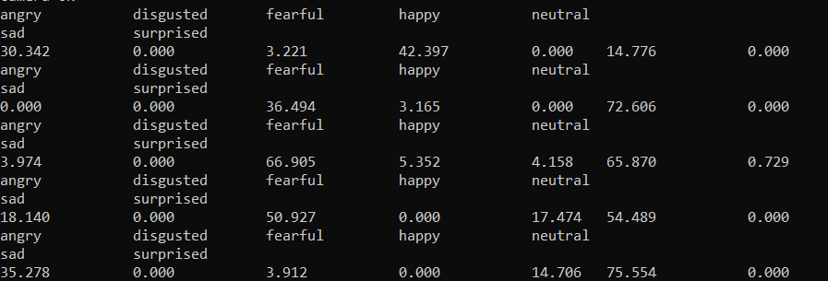
Classification output MATRIX
For Dashboard :
https://mobot-app-39805.web.app/
For AI testing :
https://colab.research.google.com/drive/1lxiOH5_TBMBtd0mHY0GGWz2ry9msAhVy?usp=sharing
Notes:
This is some statistics that will also be shown from the command line for the different moods recognised.
The highest value – 10s will be picked up and be sent to the website

Slide 5
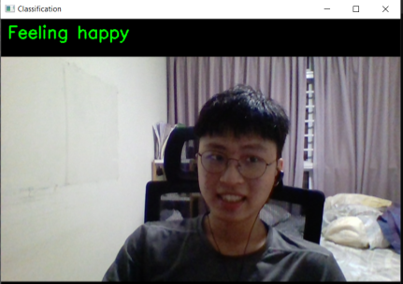
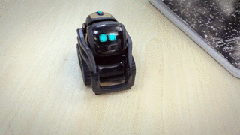
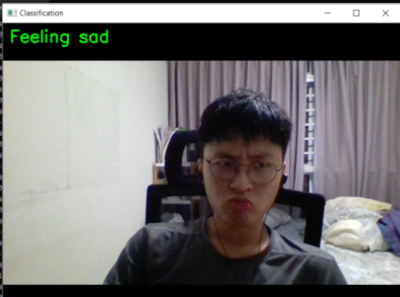
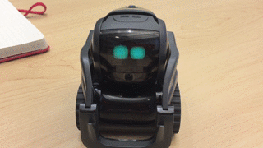
Reactions
MOBOT interacting + DISCO Music. --- Act of happiness
MOBOT comforting user+ “Don’t be sad”

Slide 6
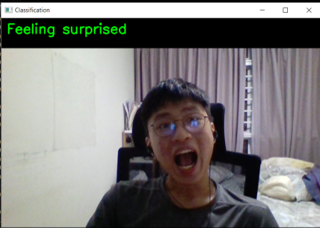
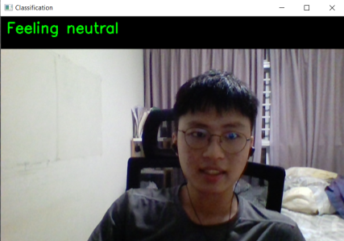
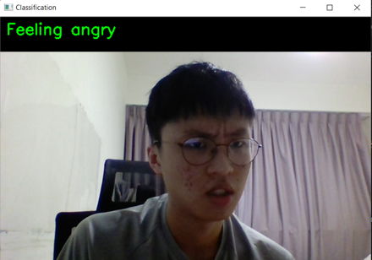
OTHER REACTIONS

Slide 7
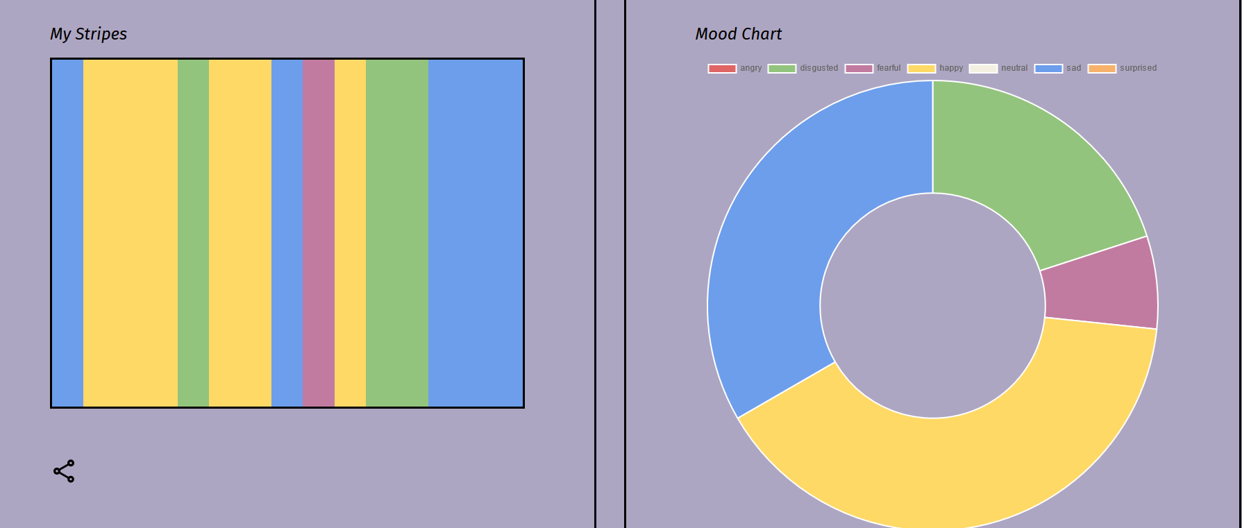
API Call
Classified as sad
Most frequent mood detected in last 20s: Sad

Slide 8

STRIPES DASHBOARD
Coded with React, hosted in Firebase
Mood Stripes as a minimalist visualisation to show the emotions of the user throughout the day
Everyday, most common feeling is recorded and will be part of the Weekly Stripes chart
Though not implemented, stripes can be shared to other social media platforms
Promotes the sharing of feelings with close friends and family!

